Slide 1
MID- TERM ASSESSMENT ENERGY USE OF APPLIANCES IN A LOW ENERGY HOUSE
PRESENTED BY,
M.RACHEL

Slide 2
DATASET
Datafile [ENB_2023.txt ]
R code [AggWaFit718.R ]
VARIABLES:
X1: Temperature in kitchen area, in Celsius
X2: Humidity in kitchen area, given as a percentage
X3: Temperature outside (from weather station), in Celsius
X4: Humidity outside (from weather station), given as a percentage
X5: Visibility (from weather station), in km
Y: Appliances, energy use, in Wh

Slide 3
SKEWNESS TABLE
 | variables | skewness_vals | inferences
1 | X1 | 0.32 | Fairly Symmetrical
2 | X2 | 0.44 | Fairly Symmetrical
3 | X3 | 0.05 | Fairly Symmetrical
4 | X4 | -0.47 | Fairly Symmetrical
5 | X5 | 0.83 | Moderately right skewed
6 | Y | 1.75 | Highly Skewed

Slide 4
CORRELATION TABLE
 | X1 | X2 | X3 | X4 | X5 | Y
X1 | 1.00 | 0.07 | 0.02 | 0.08 | 0.18 | 0.36
X2 | 0.07 | 1.00 | 0.30 | -0.01 | 0.06 | 0.18
X3 | 0.02 | 0.30 | 1.00 | -0.37 | 0.15 | 0.55
X4 | 0.08 | -0.01 | -0.37 | 1.00 | -0.10 | 0.07
X5 | 0.18 | 0.06 | 0.15 | -0.10 | 1.00 | 0.28
Y | 0.36 | 0.18 | 0.55 | 0.07 | 0.28 | 1.00

Slide 5
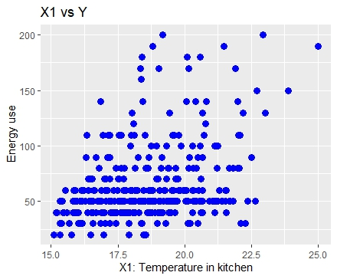
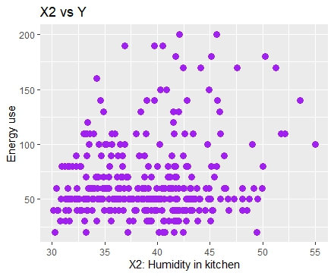
DATA DISTRIBUTIONS – SCATTER PLOT

Slide 6
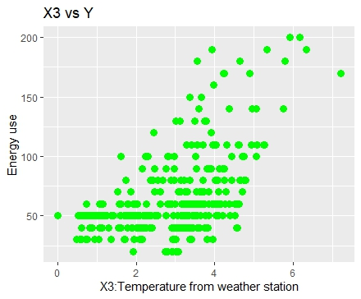
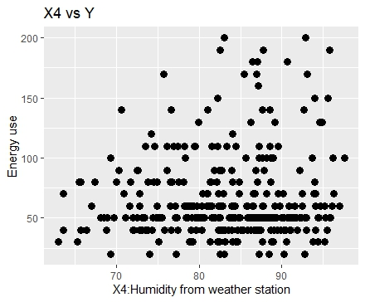
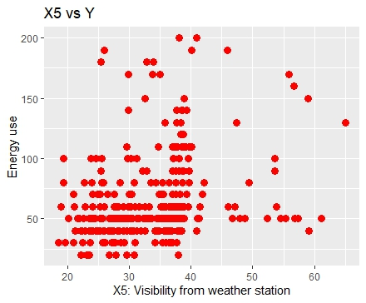

Slide 7
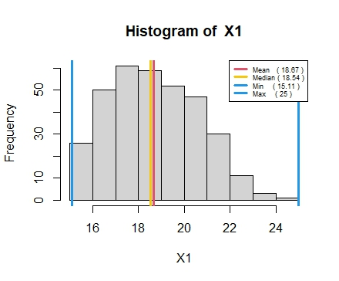
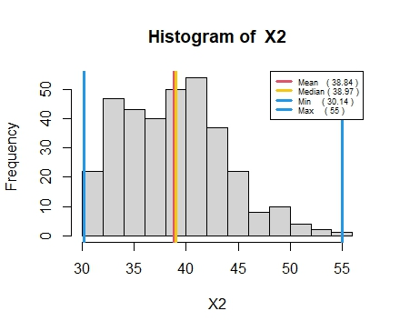
DATA DISTRIBUTION-HISTROGRAM

Slide 8
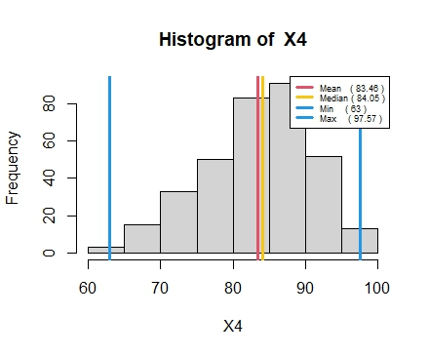
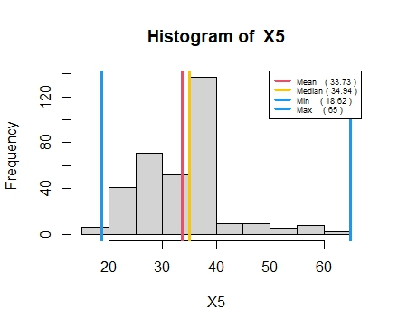

Slide 9
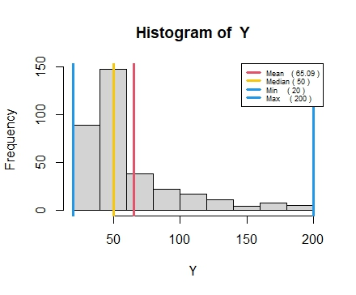

Slide 10
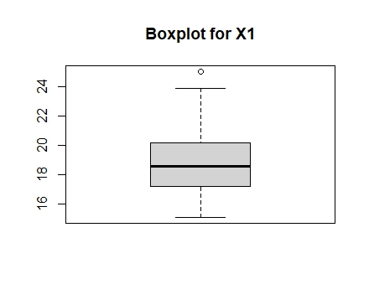
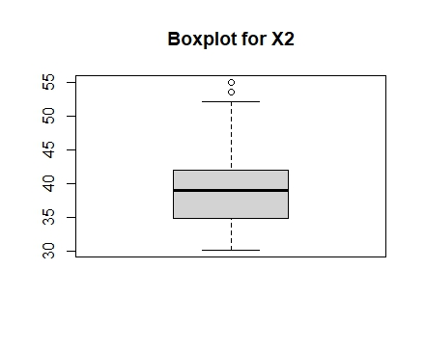
VISULIZATION OF OUTLIERS- BOXPLOT

Slide 11
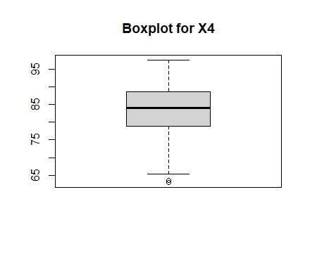
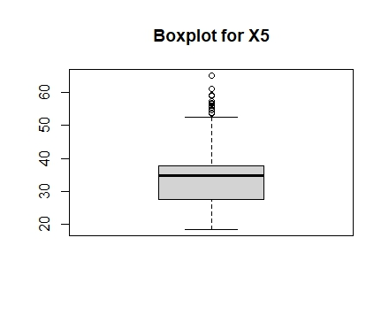
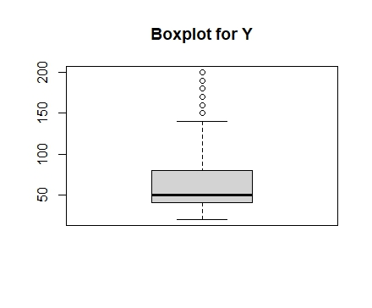

Slide 12
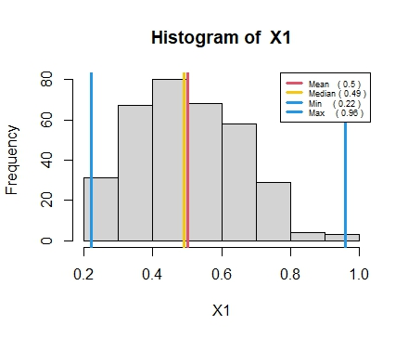
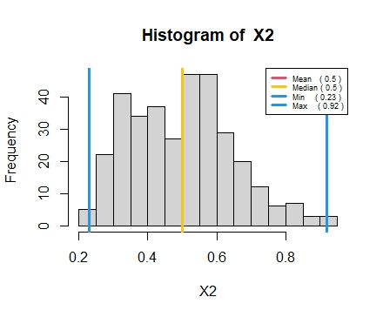
TRANSFORMED DATA-HISTOGRAM

Slide 13
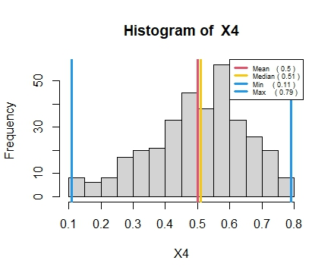
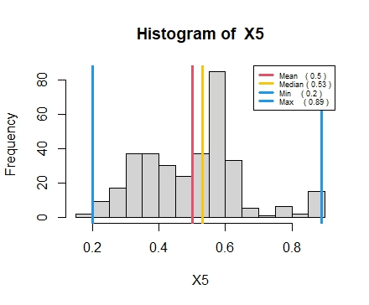

Slide 14
ERROR MEASURES AND CORRELATION TABLE
 | QAM | PM05 | QM | OWA | CHOQUET INTEGRAL
RMSE ERROR | 0.248138876360 | 0.24478300535 | 0.252927346054 | 0.23344530190 | 0.22619564847
AV. ABS ERROR | 0.212943871998 | 0.21056780176 | 0.216929458410 | 0.17556158617 | 0.17295654471
PEARSON CORRELATION | 0.418363991032 | 0.42767430744 | 0.406940251613 | 0.31488829940 | 0.36613001569
SPEARMAN CORRELATION | 0.381366903728 | 0.39920593412 | 0.357788174339 | 0.26425643675 | 0.32705610546
ORNESS |  |  |  | 0.0119113198597105 | 0.0517844336872667

Slide 15
WEIGHTS/PARAMETERS
QAM | PM05 | QM | OWA | CHOQUET INTEGRAL
0.717704556361778 | 0.644730818502836 | 0.774167224500454 | 0.964266040420875 | 0.303895357777912
0 | 0 | 0.0505036945648508 | 0.0357339595791316 | 0.265898724146154
0 | 0 | 0 | 0 | 0.126310560297991
0.282295443638204 | 0.355269181497161 | 0.175329080934691 | 0 | 0.303895357777912
0 8) 0 15) 0.999999999999968
2) 0 9) 0.0759932672635167
3) 0 10) 0
4) 0 11) 0.494757758808006
5) 0 12)0
6) 0 13) 13 0.0759932672635167
7) 0 14)0

Slide 16
BEST PERFORMING MODEL
Among all models CHOQUET INTEGERAL performed better with Low RMSE error, high spearman correlation when compared with the model of second low RMSE error and spearman correlation
PREDICTED Y value = 95.41772

Slide 17
THANK YOU…

